Slide 1
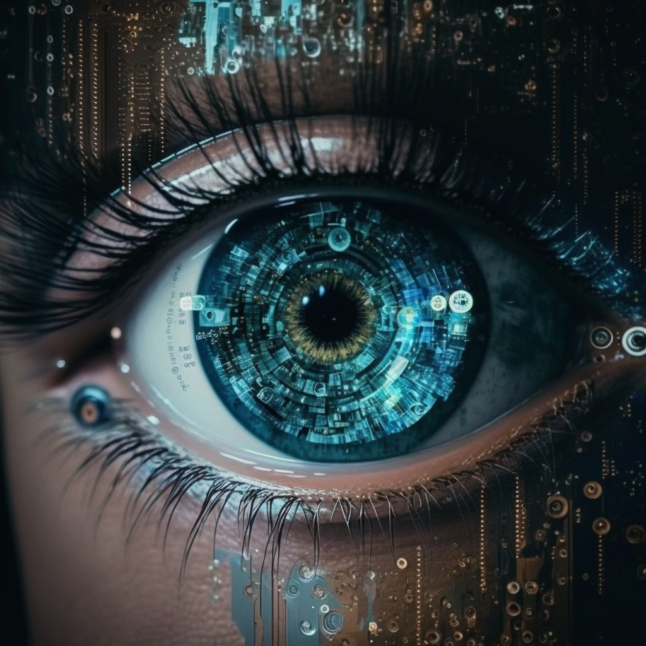

computer vision
midjourney bot (2023)
Machine Learning Methods for Biomedical Data (D012554)

Slide 2
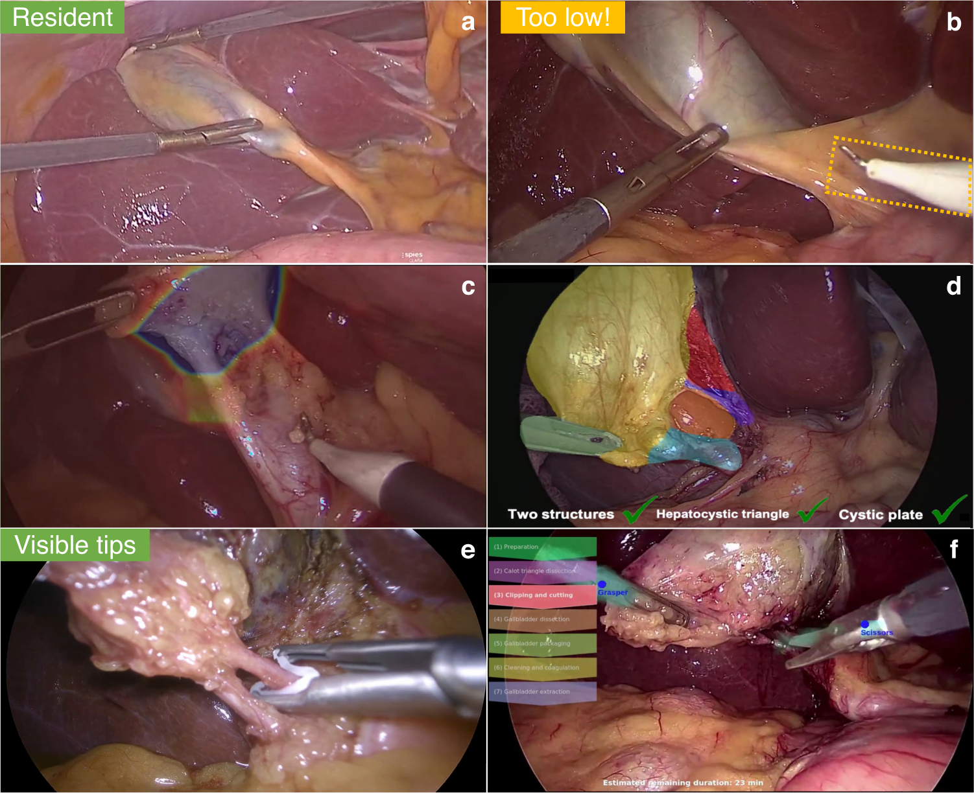
computer vision
Derive meaningful information from digital images, videos and other visual inputs.
Take actions or make recommendations based on that information.
Mascagni, P., Alapatt, D., Sestini, L. et al. Computer vision in surgery: from potential to clinical value. npj Digit. Med. 5, 163 (2022)
Machine Learning Methods for Biomedical Data (D012554)

Slide 3
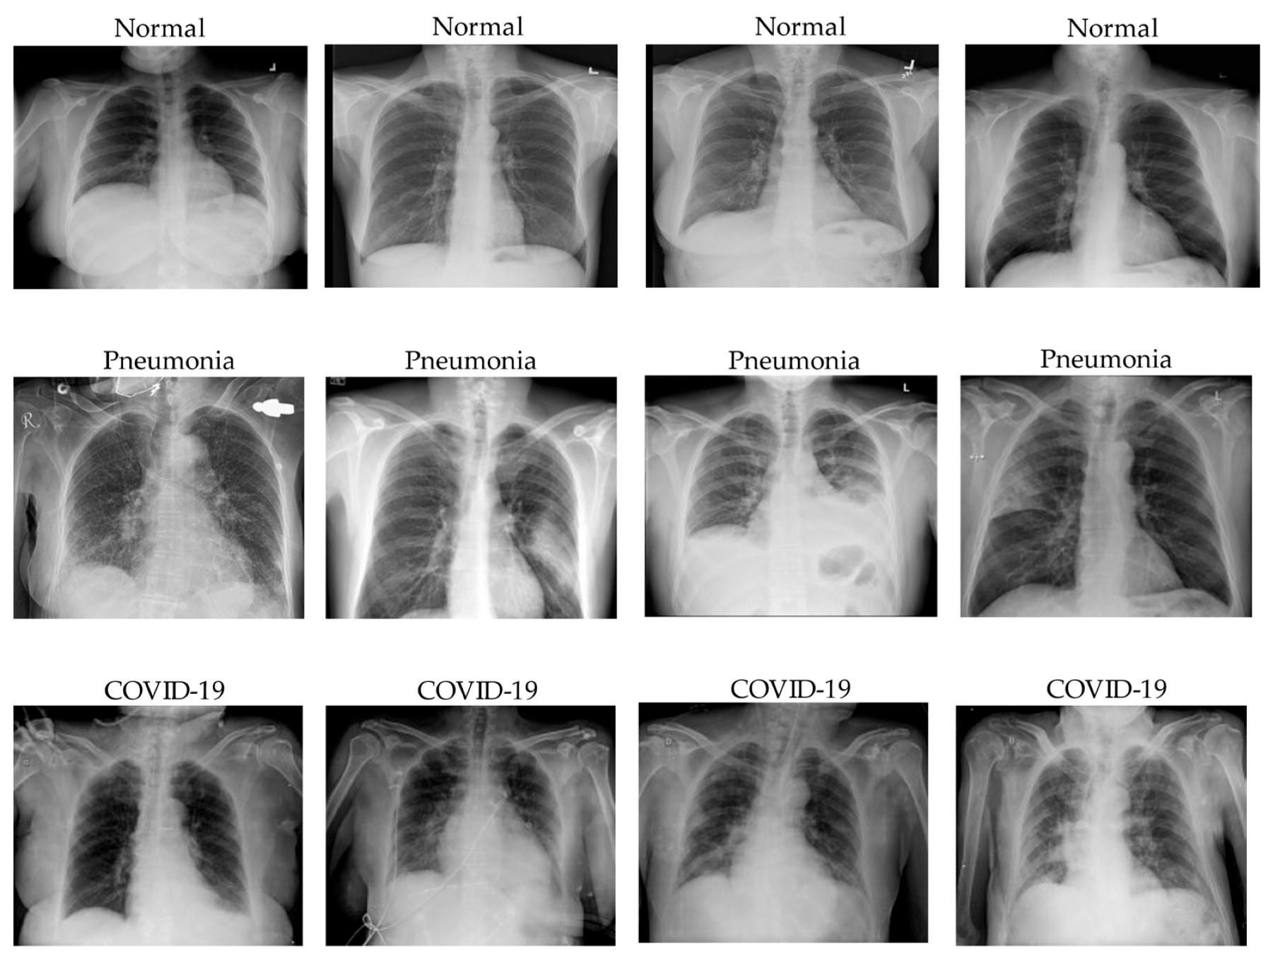
computer vision
Classification: predict the class(es) an image or video belongs to.
Le Dinh, T, et al. COVID-19 Chest X-ray Classification and Severity Assessment Using Convolutional and Transformer Neural Networks. Appl. Sci. 2022, 12, 4861
Machine Learning Methods for Biomedical Data (D012554)

Slide 4
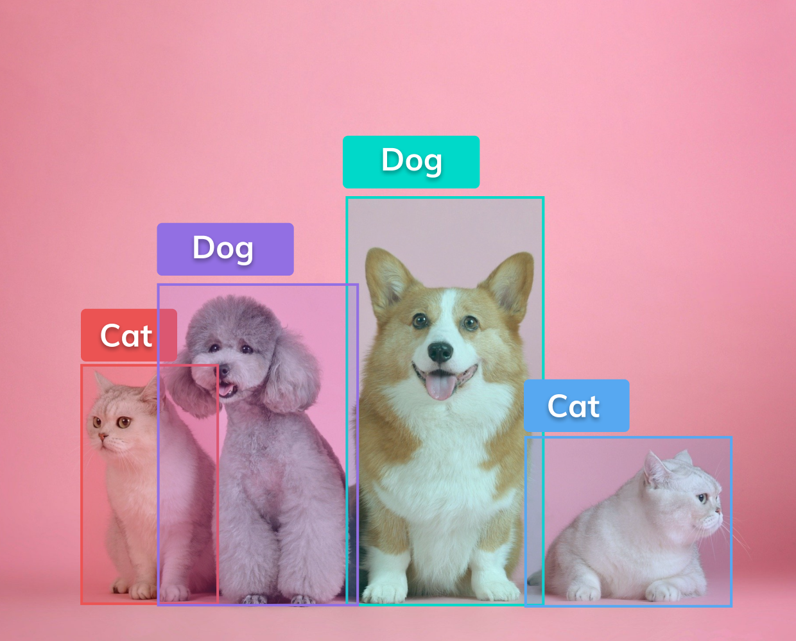
computer vision
Classification: predict the class(es) an image or video belongs to.
Object detection: identify a certain class of image and then detect and tabulate their appearance in an image or video.
Machine Learning Methods for Biomedical Data (D012554)

Slide 5
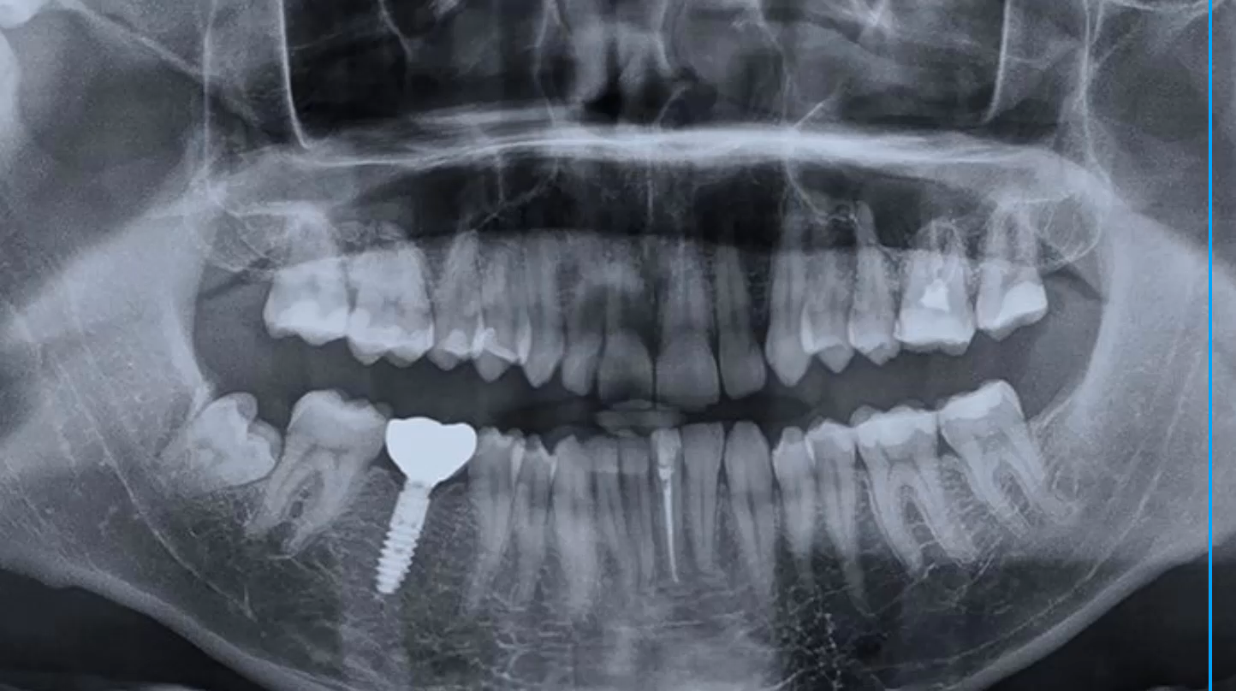
computer vision
Classification: predict the class(es) an image or video belongs to.
Object detection: identify a certain class of image and then detect and tabulate their appearance in an image or video.
Machine Learning Methods for Biomedical Data (D012554)

Slide 6
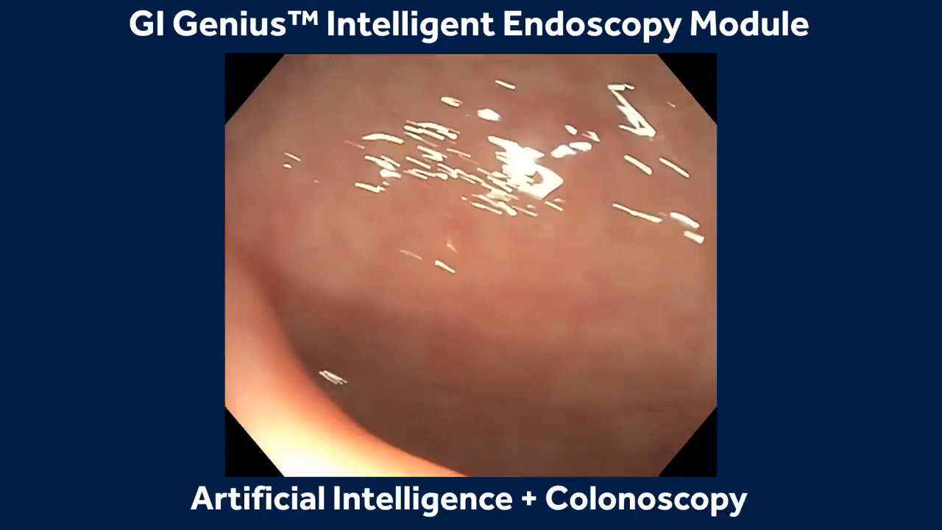
computer vision
Classification: predict the class(es) an image or video belongs to.
Object detection: identify a certain class of image and then detect and tabulate their appearance in an image or video.
Machine Learning Methods for Biomedical Data (D012554)

Slide 7
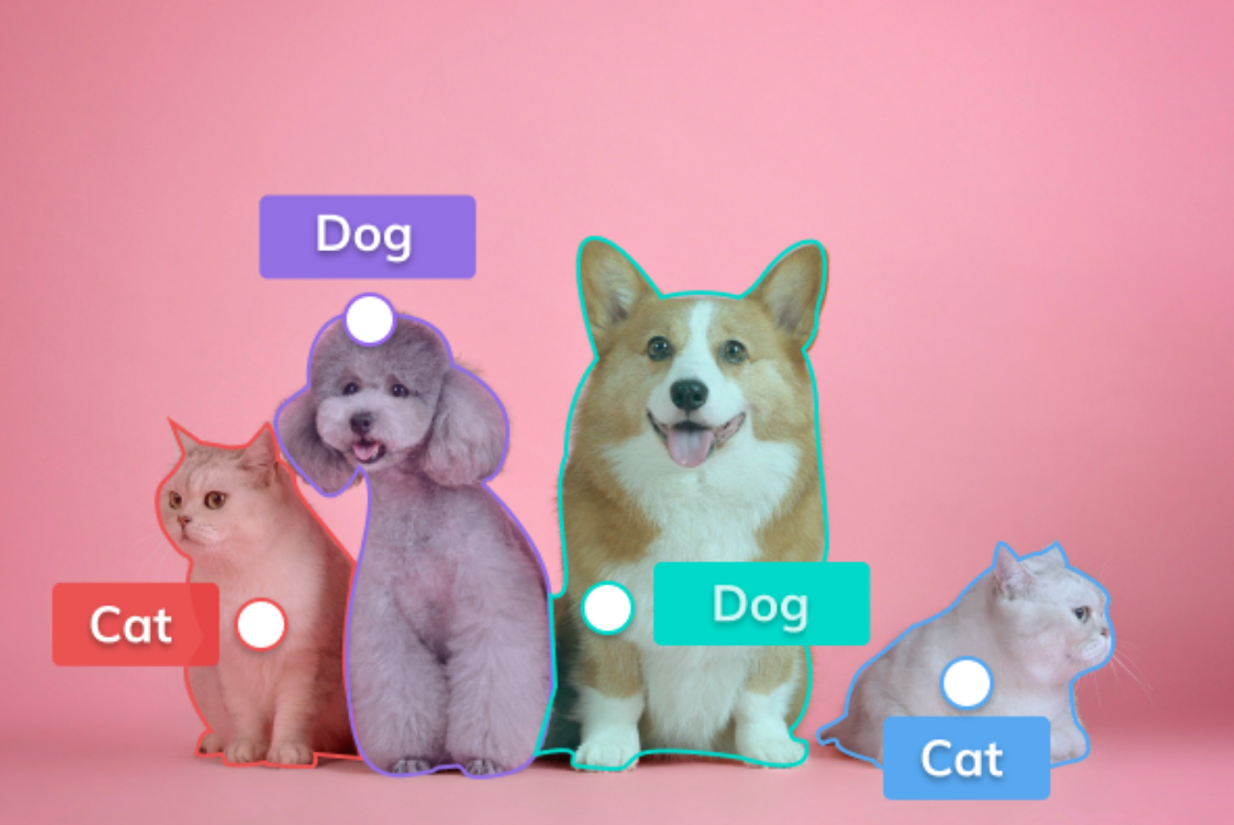
computer vision
Classification: predict the class(es) an image or video belongs to.
Object detection: identify a certain class of image and then detect and tabulate their appearance in an image or video.
Segmentation: the process of partitioning a digital image into multiple image segments (regions).
Machine Learning Methods for Biomedical Data (D012554)

Slide 8
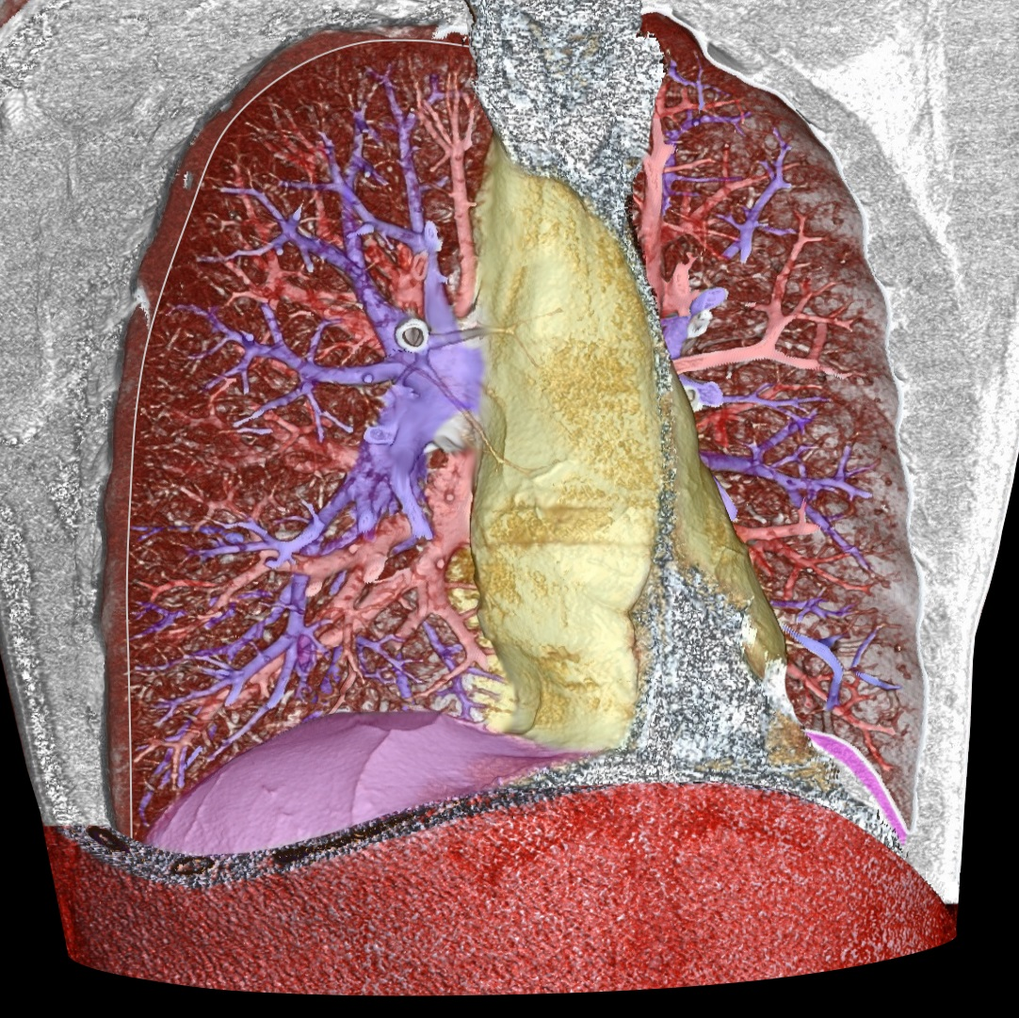
computer vision
Classification: predict the class(es) an image or video belongs to.
Object detection: identify a certain class of image and then detect and tabulate their appearance in an image or video.
Segmentation: the process of partitioning a digital image into multiple image segments (regions).
pulmonary arteries: blue; pulmonary veins (and also the abdominal wall): red; the mediastinum: yellow; the diaphragm: violet
Machine Learning Methods for Biomedical Data (D012554)

Slide 9
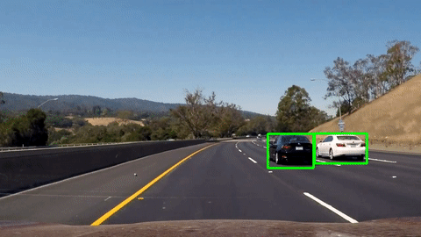
computer vision
Classification: predict the class(es) an image or video belongs to.
Object detection: identify a certain class of image and then detect and tabulate their appearance in an image or video.
Segmentation: the process of partitioning a digital image into multiple image segments (regions).
Object tracking: follow the movement of an object in a video.
Machine Learning Methods for Biomedical Data (D012554)

Slide 10
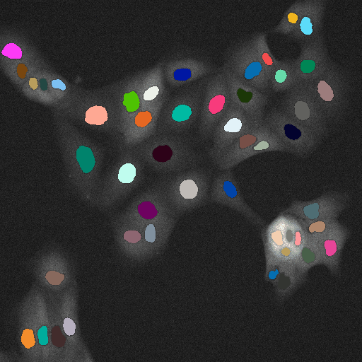
computer vision
Classification: predict the class(es) an image or video belongs to.
Object detection: identify a certain class of image and then detect and tabulate their appearance in an image or video.
Segmentation: the process of partitioning a digital image into multiple image segments (regions).
Object tracking: follow the movement of an object in a video.
https://imaging.cs.msu.ru/en/research/cell-tracking
Machine Learning Methods for Biomedical Data (D012554)

Slide 11
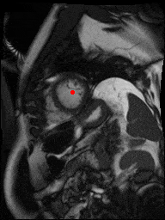
computer vision
Classification: predict the class(es) an image or video belongs to.
Object detection: identify a certain class of image and then detect and tabulate their appearance in an image or video.
Segmentation: the process of partitioning a digital image into multiple image segments (regions).
Object tracking: follow the movement of an object in a video.
kaggle.com/second-annual-data-science-bowl (2015)
Machine Learning Methods for Biomedical Data (D012554)

Slide 12
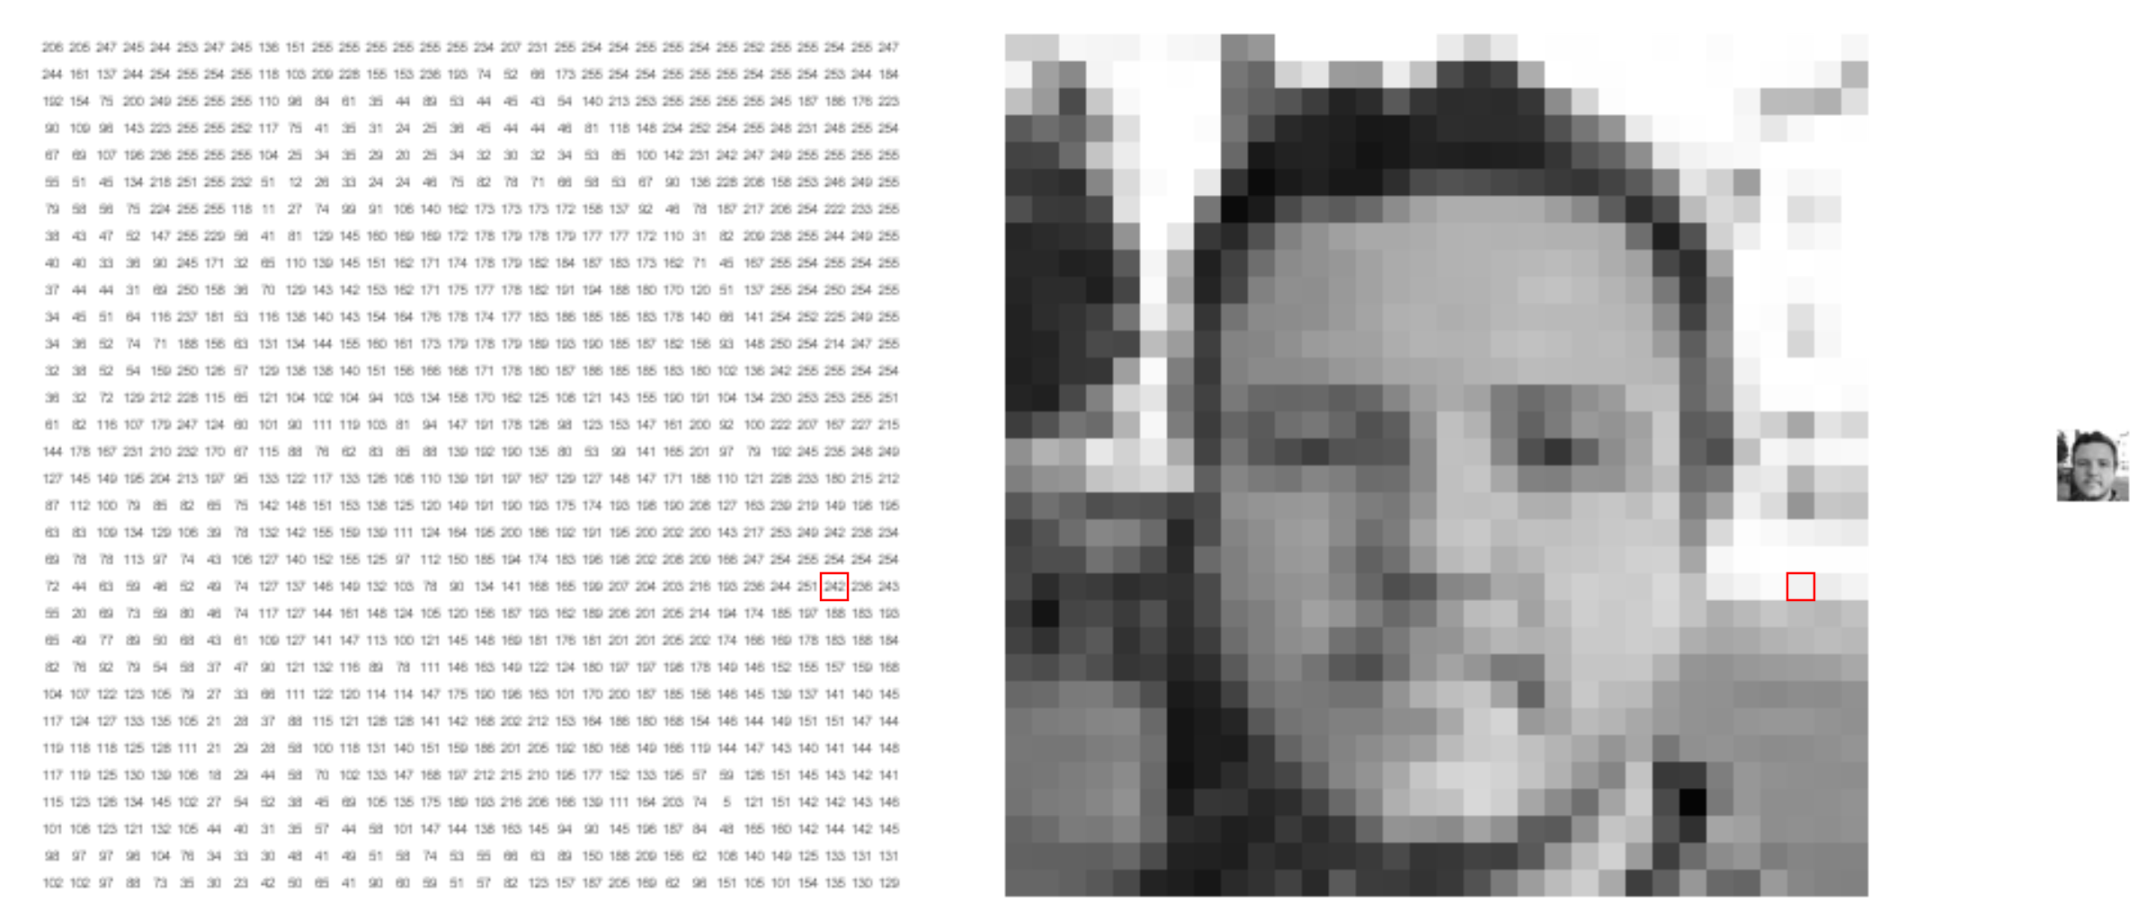
what computers see
https://setosa.io/ev/image-kernels/
Machine Learning Methods for Biomedical Data (D012554)
Notes:
Shifts
Scale
anngles
Shadows

Slide 13
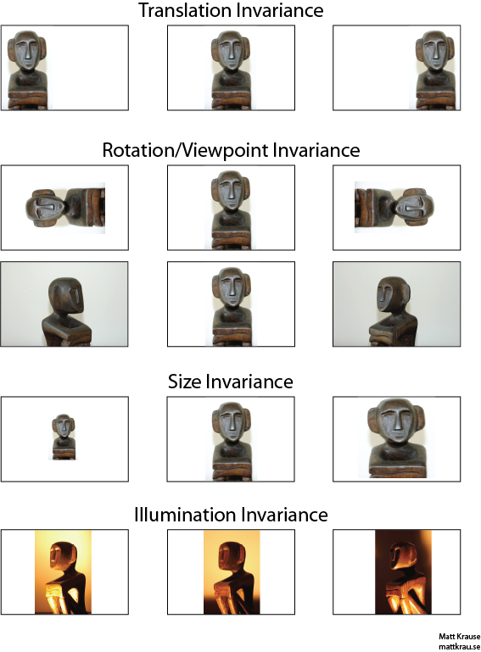
invariances
Invariance means that we can recognize an object as an object, even when its appearance varies in some way.
Machine Learning Methods for Biomedical Data (D012554)
Notes:
Shifts
Scale
anngles
Shadows

Slide 14
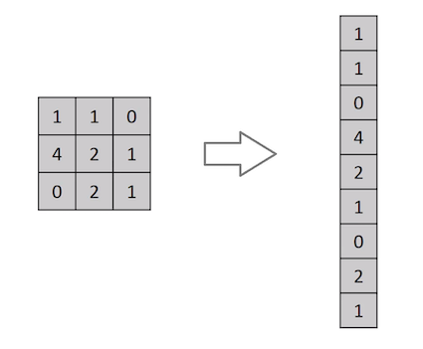
flatten
We could just represent each pixel as a feature.
This would mean that we flatten the 2D matrix to a 1D feature vector.
The learning algorithm then needs to learn the 2D spatial correlations from the 1D representation.
And what with the invariances?
Machine Learning Methods for Biomedical Data (D012554)
Notes:
Shifts
Scale
anngles
Shadows

Slide 15
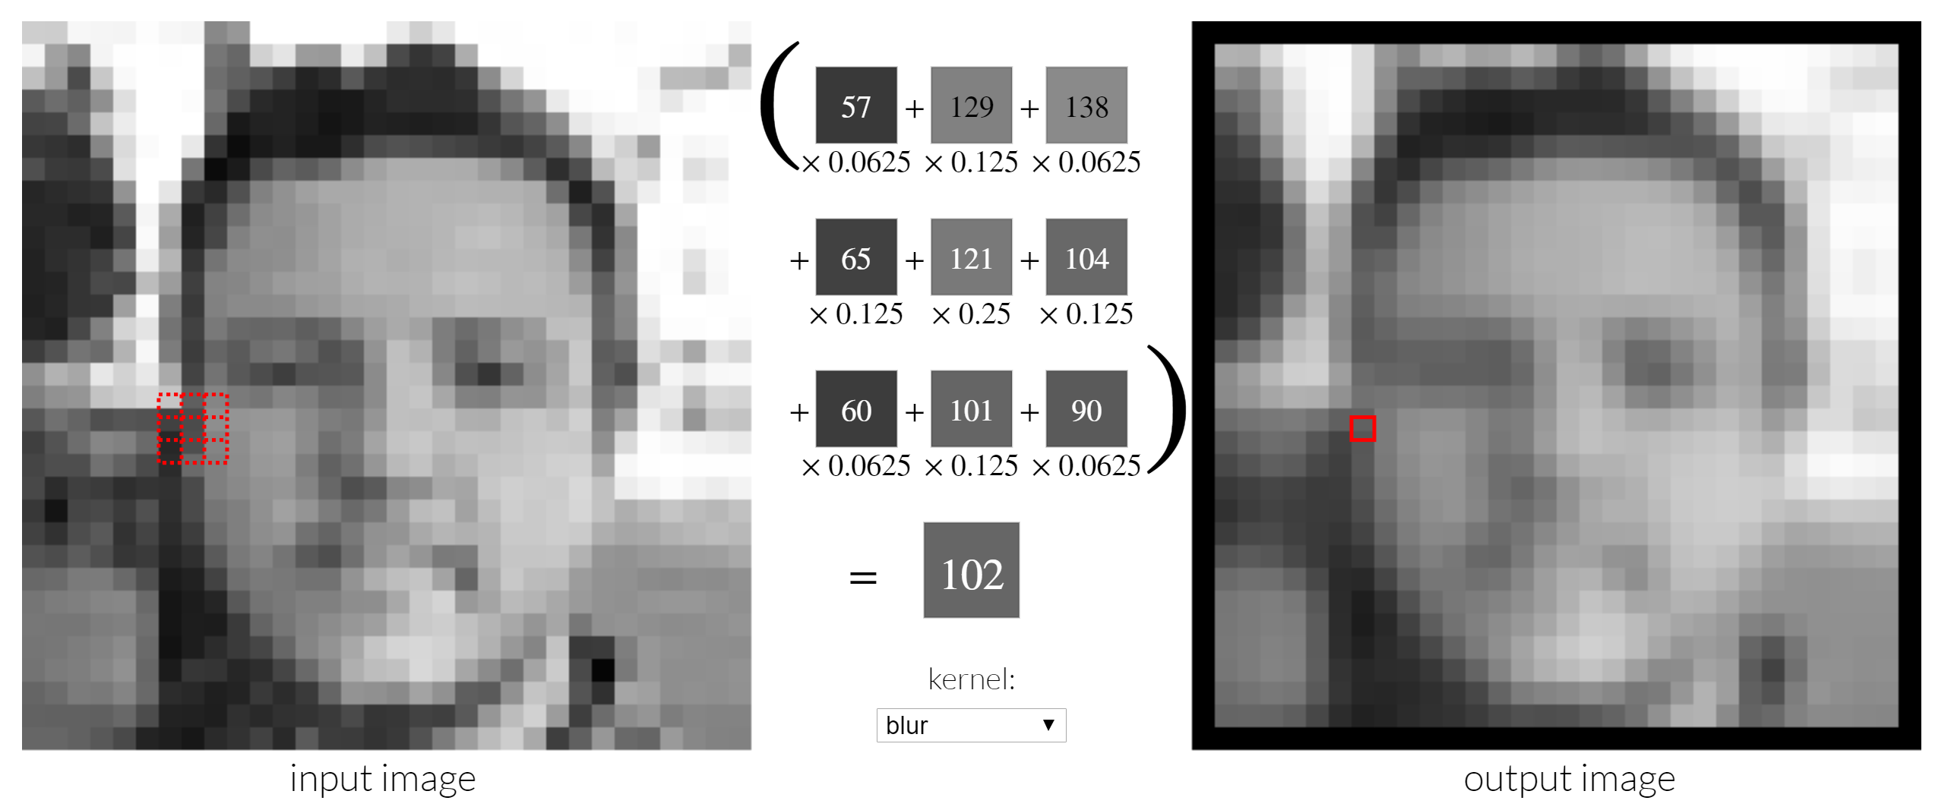
convolutional filter
Convolutional filters are small matrices that are “slid” over an image.
They provides a measure for how close a patch or a region in the image resembles a feature.
Machine Learning Methods for Biomedical Data (D012554)
Notes:
Shifts
Scale
anngles
Shadows

Slide 16

convolutional neural networks (CNN)
A convolutional neural network (CNN) module stacks modules that consist of
- feature maps (or channels) that each learn a relevant convolutional filter with specific dimensions, and
- a pooling layer that allows for the location invariance of the learned features.
Machine Learning Methods for Biomedical Data (D012554)
Notes:
Shifts
Scale
anngles
Shadows

Slide 17
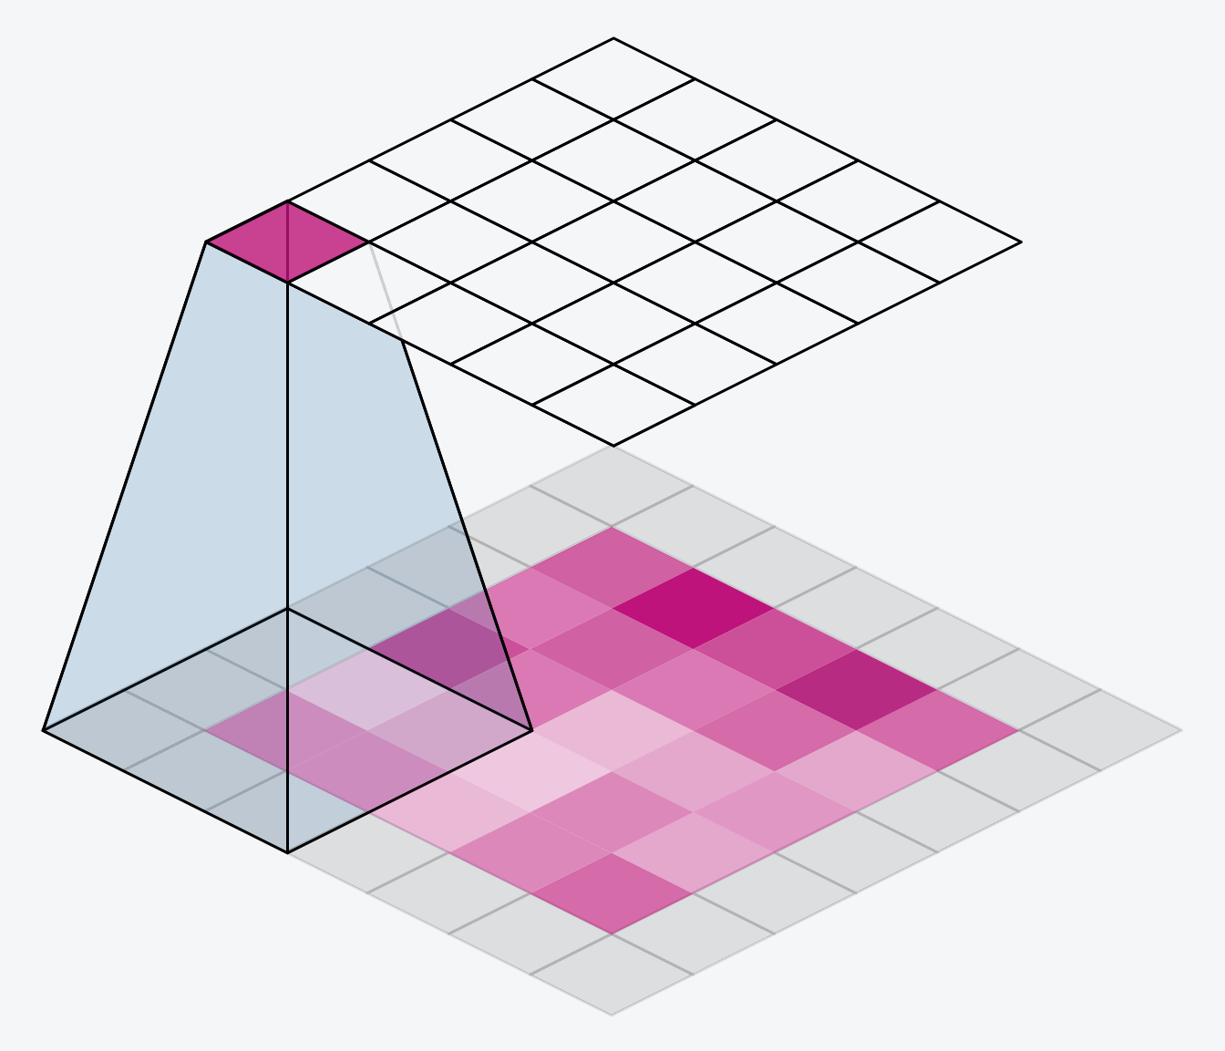
feature map
Each neuron looks at a different (overlapping) part in the image and performs a convolution.
The convolution is defined by the modelparameters that are learned from the data.
So, in each feature maps, the modelparameters for each neuron have the same value, i.e. they are shared. The only difference is in what part of the image the neuron looks at.
Machine Learning Methods for Biomedical Data (D012554)
Notes:
Shifts
Scale
anngles
Shadows

Slide 18
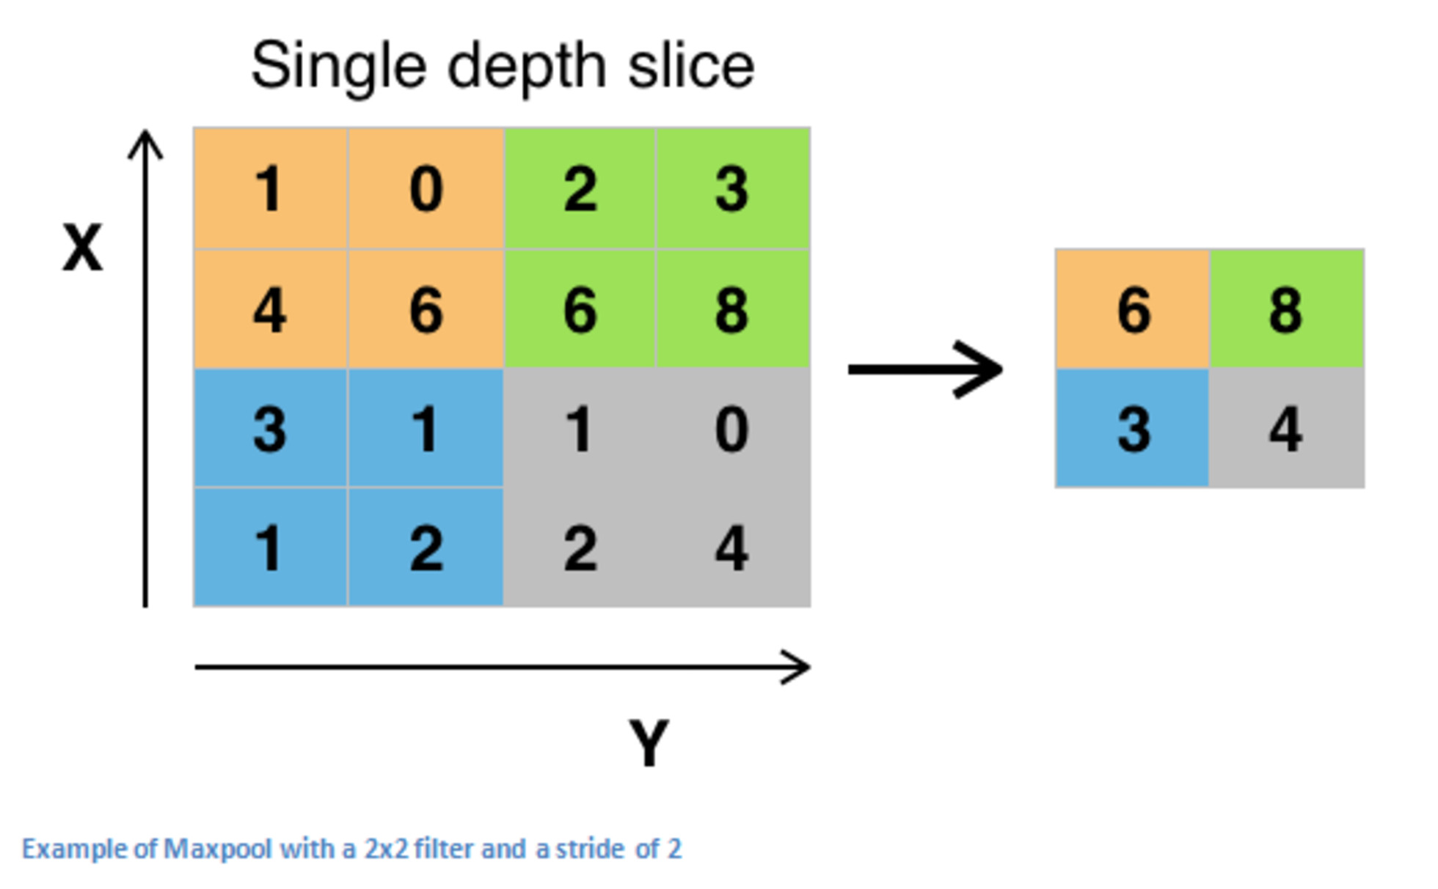
pooling layer
Maximum pooling, or max pooling, is a pooling operation that calculates the maximum, or largest, value in each patch of each feature map.
Machine Learning Methods for Biomedical Data (D012554)
Notes:
Shifts
Scale
anngles
Shadows

Slide 19
Invariances: data augmentation
CNNs are
translation invariant,
scale invariant to some degree (learned from data, not in filters),
not rotation invariant (learned from data),
not illumination invariant (learned from data).
We can generate artificial data, by rotating, scaling, illuminating training images. A process called data augmentation. This is a form of model regularization.
Machine Learning Methods for Biomedical Data (D012554)
Notes:
Shifts
Scale
anngles
Shadows

Slide 20
convolutional neural network module
Machine Learning Methods for Biomedical Data (D012554)

Slide 21


convolutional neural network module
Machine Learning Methods for Biomedical Data (D012554)
Notes:
Shifts
Scale
anngles
Shadows

Slide 22
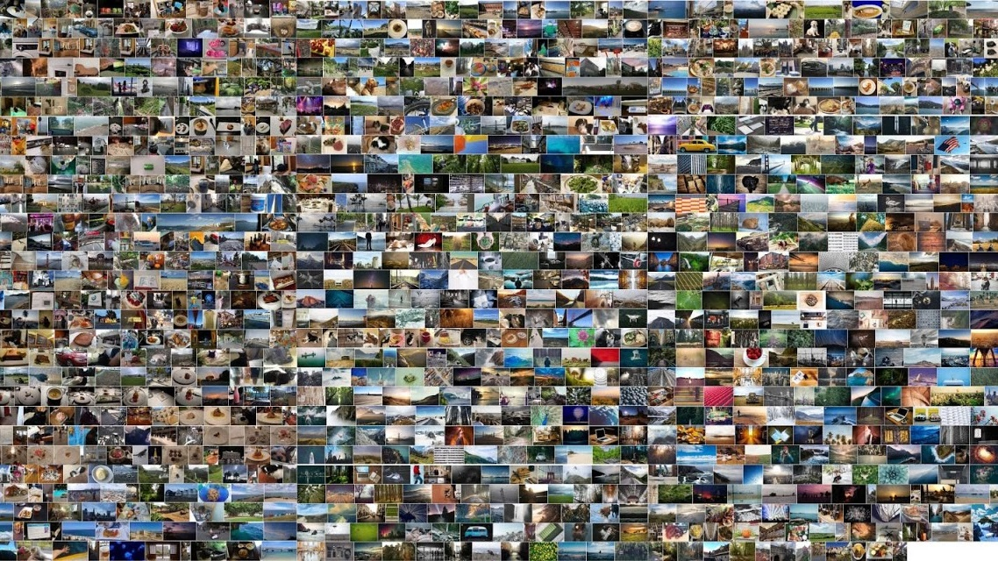
data is everything: ImageNet
J. Deng et al., "ImageNet: A large-scale hierarchical image database," 2009 IEEE Conference on Computer Vision and Pattern Recognition
Machine Learning Methods for Biomedical Data (D012554)
Notes:
14.197.122 images
21.841 subcategories
27 high-level categories

Slide 23
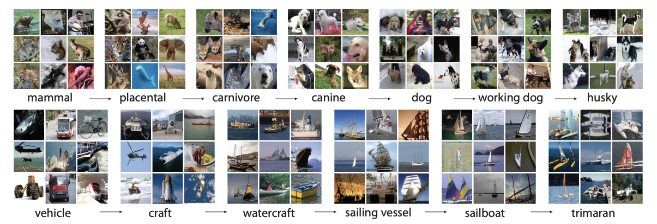
data is everything: ImageNet
Machine Learning Methods for Biomedical Data (D012554)
Notes:
Shifts
Scale
anngles
Shadows

Slide 24
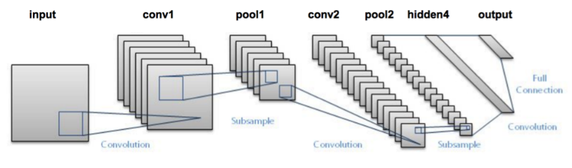
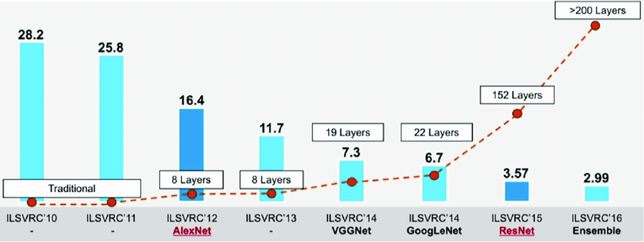
ImageNet: computer vision is solved
LeNet-5 (1998)
ImageNet Large Scale Visual Recognition Challenge: https://www.image-net.org/challenges/LSVRC/
Machine Learning Methods for Biomedical Data (D012554)
Notes:
LeNet-5, a pioneering 7-level convolutional network by LeCun et al in 1998, that classifies digits, was applied by several banks to recognise hand-written numbers on checks (cheques) digitized in 32x32 pixel greyscale inputimages. The ability to process higher resolution images requires larger and more convolutional layers, so this technique is constrained by the availability of computing resources.

Slide 25
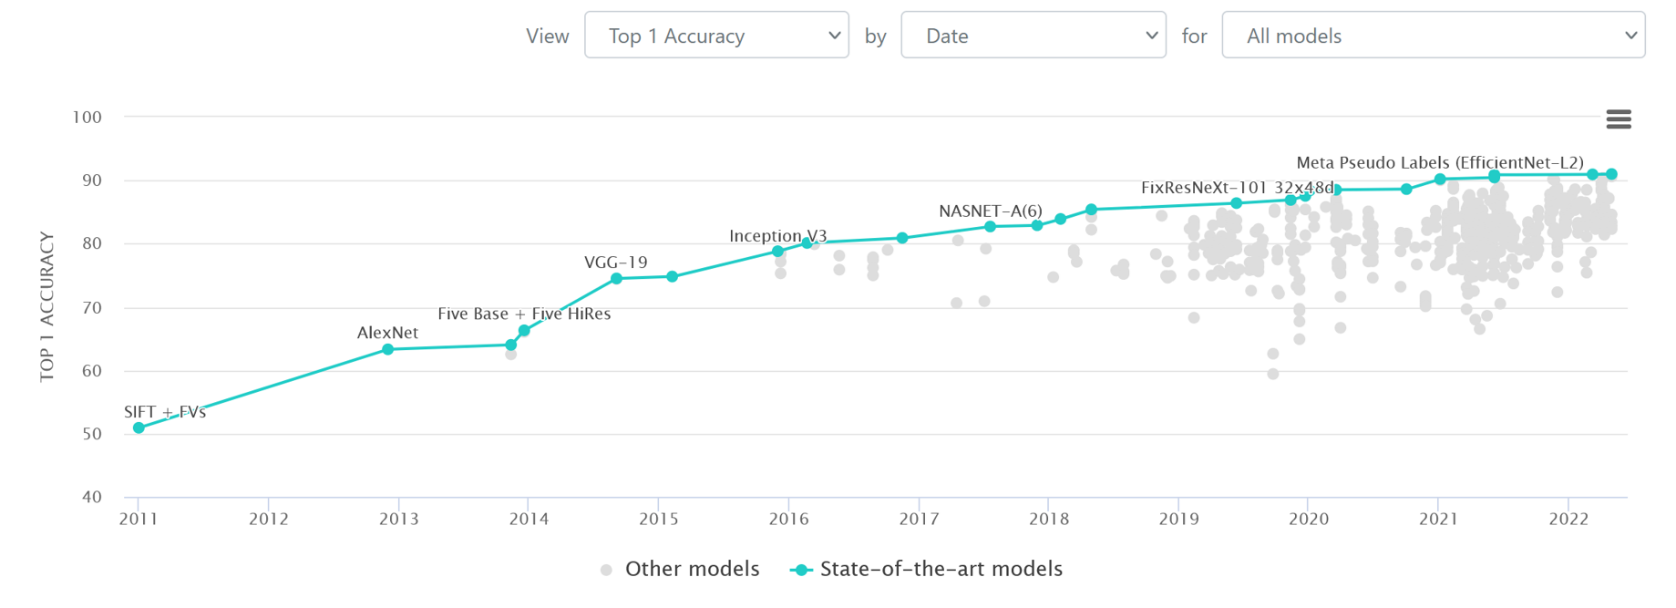
ImageNet: computer vision is solved
https://paperswithcode.com/sota/image-classification-on-imagenet
Machine Learning Methods for Biomedical Data (D012554)

Slide 26
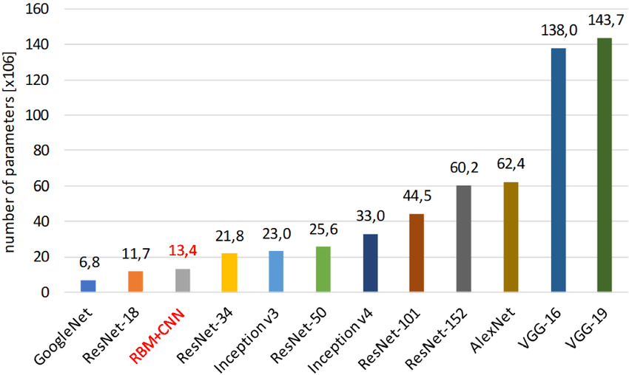
compute cost
Sobczak, Szymon & Kapela, et al. (2021). Restricted Boltzmann machine as an aggregation technique for binary descriptors. The Visual Computer. 37. 1-10.
Machine Learning Methods for Biomedical Data (D012554)

Slide 27
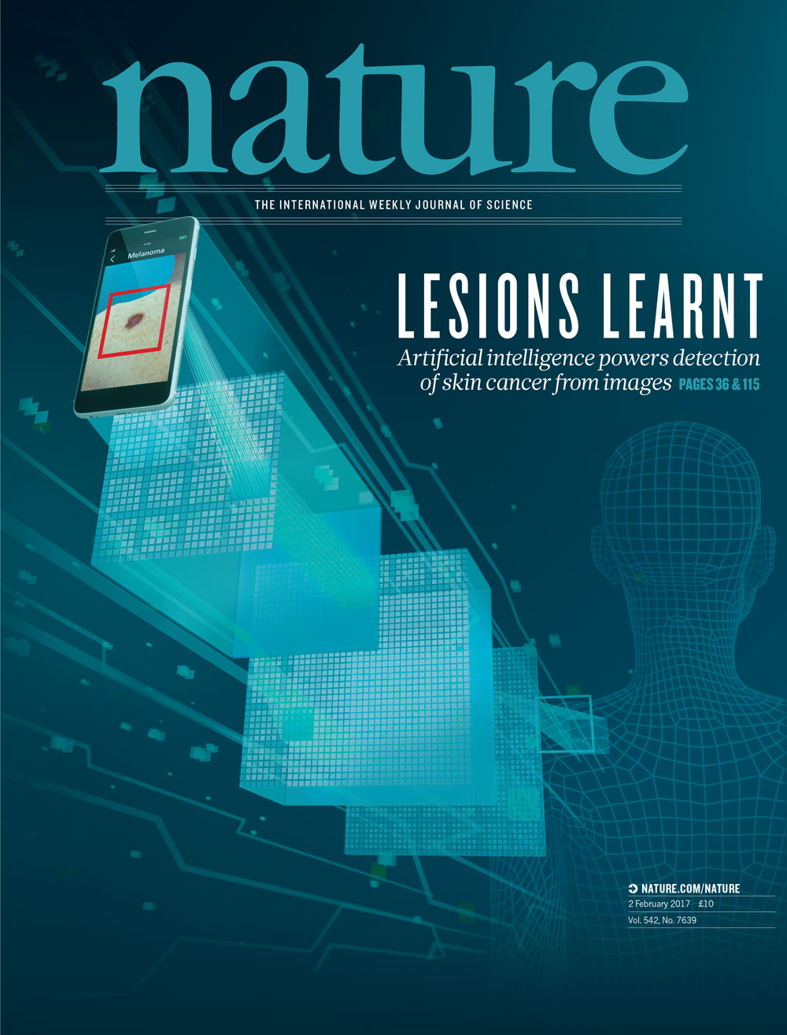
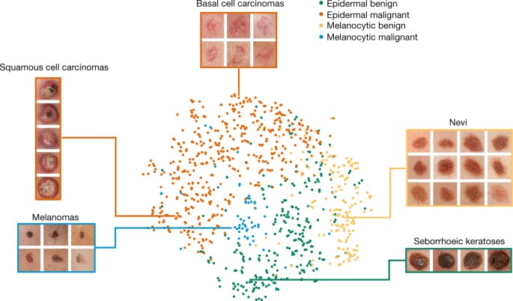
recent advances: melanoma
Thrun et al., Dermatologist-level classification of skin cancer with deep neural networks, Nature (2017)
Machine Learning Methods for Biomedical Data (D012554)

Slide 28
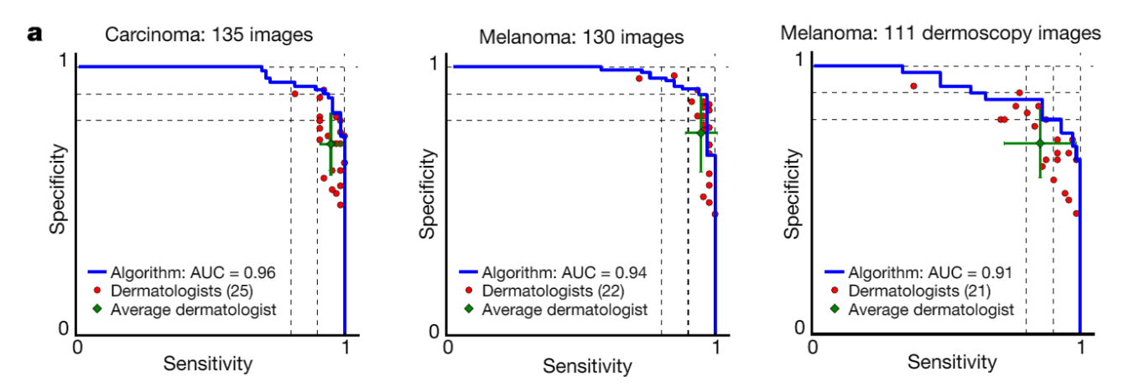
recent advances: melanoma
keratinocyte carcinomas: 65
benign seborrheic keratoses: 75
malignant melanomas: 33
benign nevi: 97
malignant melanomas: 71
benign nevi: 40
Thrun et al., Dermatologist-level classification of skin cancer with deep neural networks, Nature (2017)
Machine Learning Methods for Biomedical Data (D012554)

Slide 29
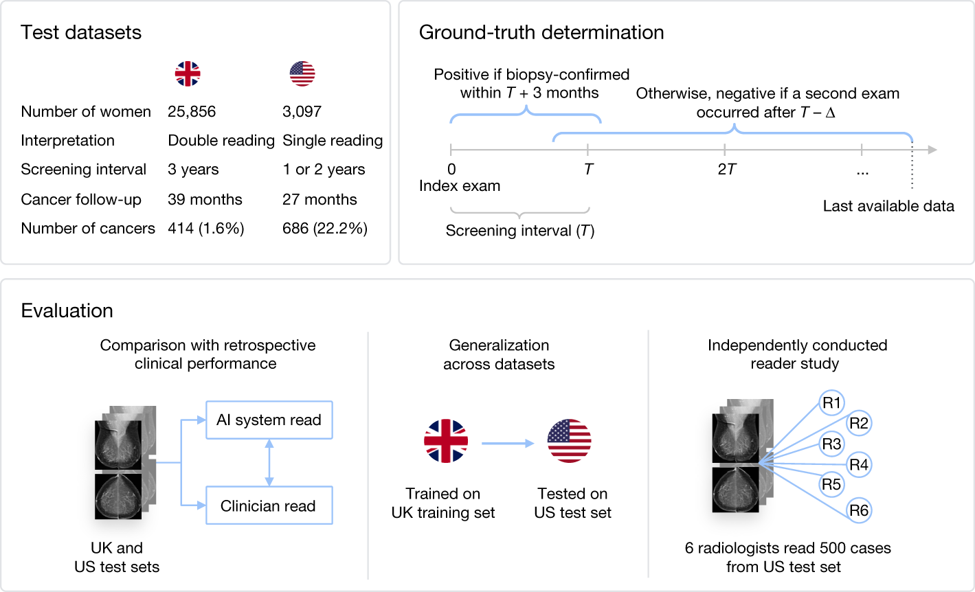
recent advances: breast cancer screening
McKinney, S.M., Sieniek, M., Godbole, V. et al. International evaluation of an AI system for breast cancer screening. Nature 577, 89–94 (2020)
Machine Learning Methods for Biomedical Data (D012554)

Slide 30
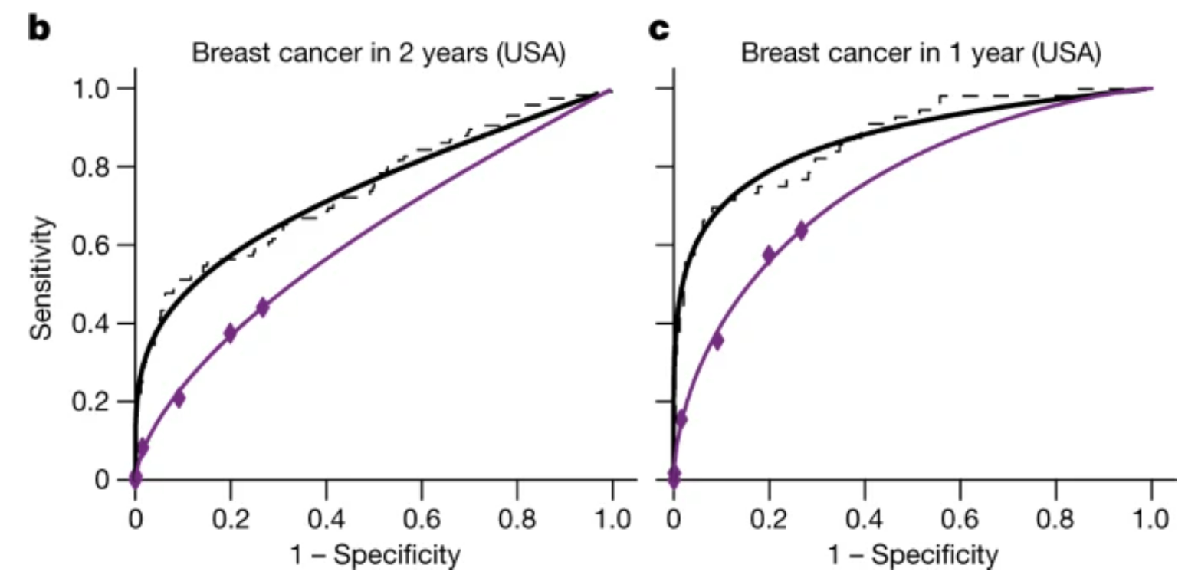
recent advances: breast cancer screening
Pooled ROC results from all six readers(purple) versus AI model (black).
McKinney, S.M., Sieniek, M., Godbole, V. et al. International evaluation of an AI system for breast cancer screening. Nature 577, 89–94 (2020)
Machine Learning Methods for Biomedical Data (D012554)

Slide 31
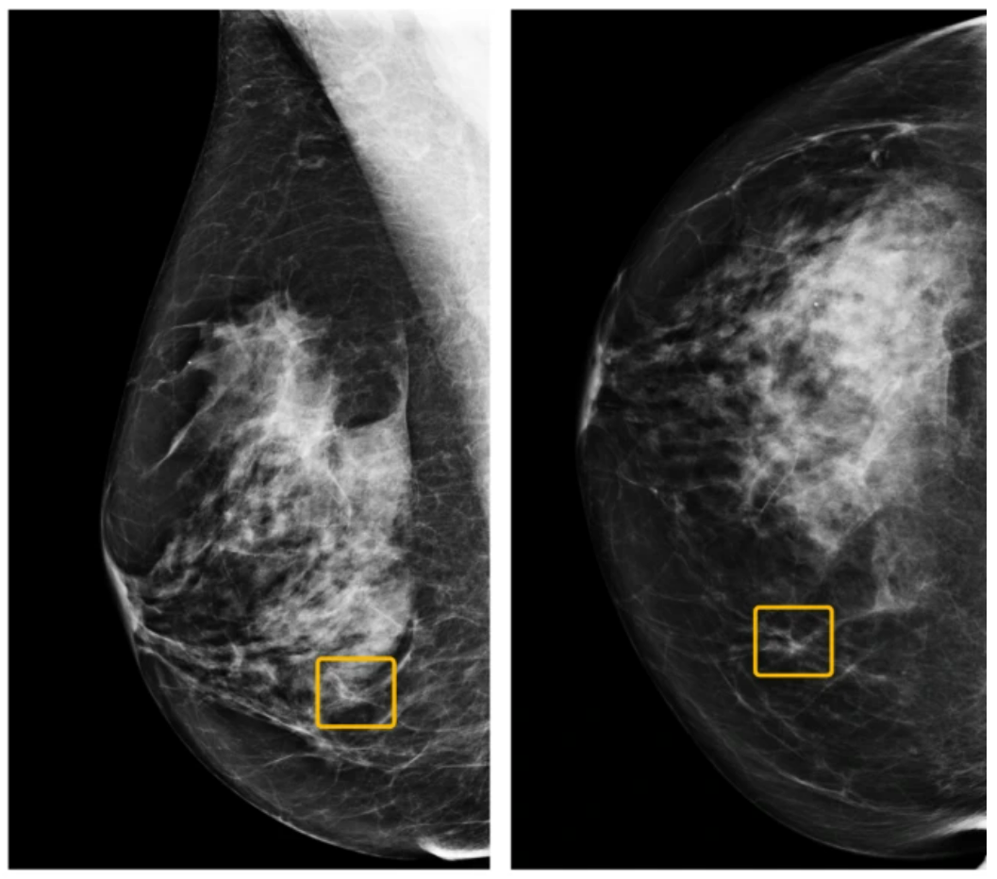
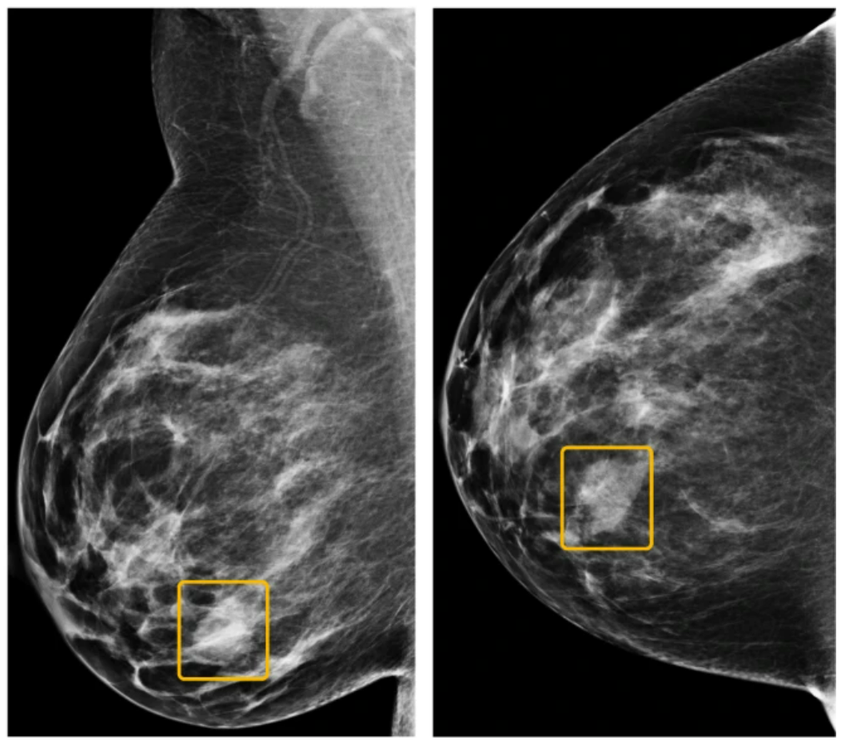
recent advances: breast cancer screening
missed by readers missed by AI model
McKinney, S.M., Sieniek, M., Godbole, V. et al. International evaluation of an AI system for breast cancer screening. Nature 577, 89–94 (2020)
Machine Learning Methods for Biomedical Data (D012554)

Slide 32
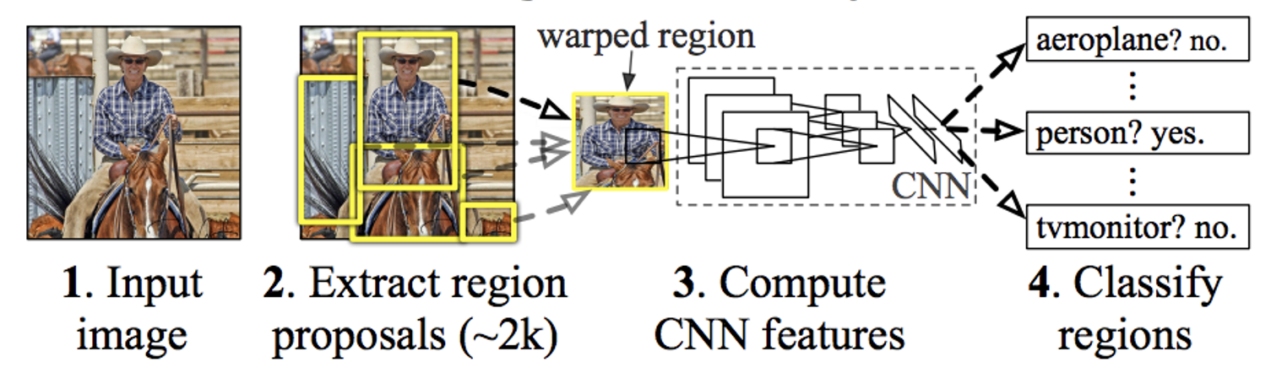
object detection: R-CNN
Use selective search to extract just 2000 regions from the image (called region proposals):
1. Generate initial sub-segmentation, we generate many candidate regions. 2. Use greedy algorithm to recursively combine similar regions into larger ones. 3. Use the generated regions to produce the final candidate region proposals.
Then warp the regions into a square and classify them using a CNN.
Ross Girshick et al., Rich feature hierarchies for accurate object detection and semantic segmentation (2014), arXiv
Machine Learning Methods for Biomedical Data (D012554)

Slide 33
object detection: R-CNN
https://www.nature.com/articles/s41467-022-30695-9
Ross Girshick et al., Rich feature hierarchies for accurate object detection and semantic segmentation (2014), arXiv

Slide 34
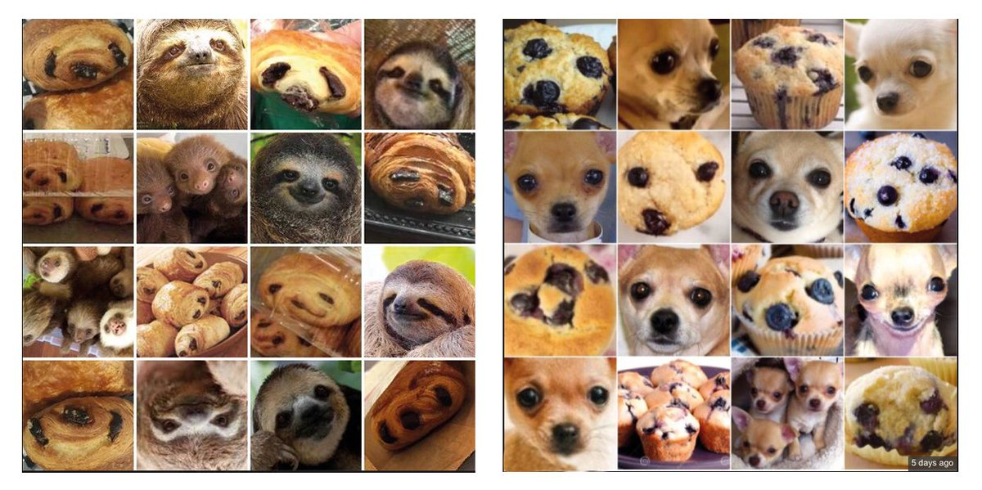
ImageNet: computer vision is solved?
Machine Learning Methods for Biomedical Data (D012554)

Slide 35
what computers see
Machine Learning Methods for Biomedical Data (D012554)
Notes:
Shifts
Scale
anngles
Shadows

Slide 36
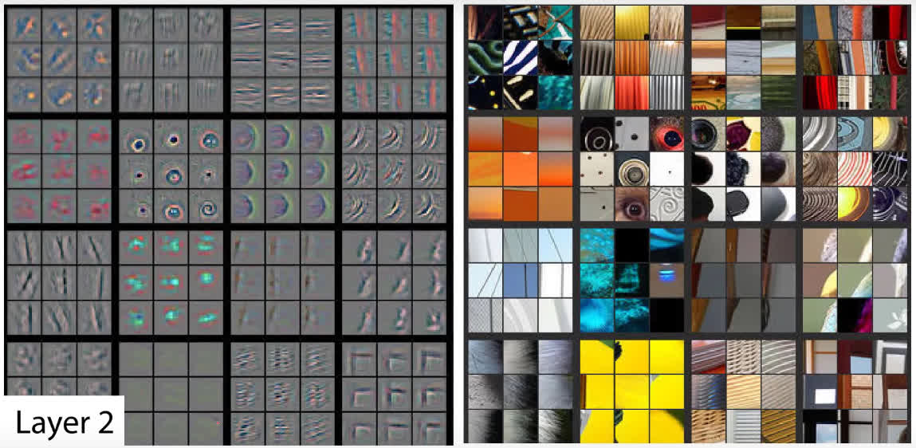
what computers see
On the left, each square is a different feature map (convolutional filter) with the activations shown for the corresponding images on the right (these images are selected such that they maximize the activation of the filter.
Zeiler, M. D., & Fergus, R. (2014, September). Visualizing and understanding convolutional networks. In European conference on computer vision (pp. 818-833)
Machine Learning Methods for Biomedical Data (D012554)
Notes:
Shifts
Scale
anngles
Shadows

Slide 37
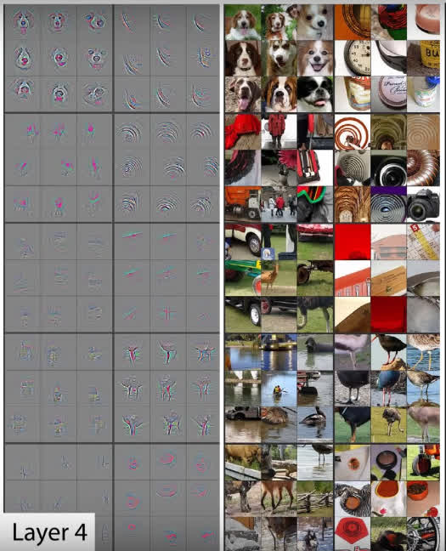
what computers see
The patterns that the filters detect become more complex as we go deeper into the network.
Zeiler, M. D., & Fergus, R. (2014, September). Visualizing and understanding convolutional networks. In European conference on computer vision (pp. 818-833)
Machine Learning Methods for Biomedical Data (D012554)
Notes:
Shifts
Scale
anngles
Shadows

Slide 38
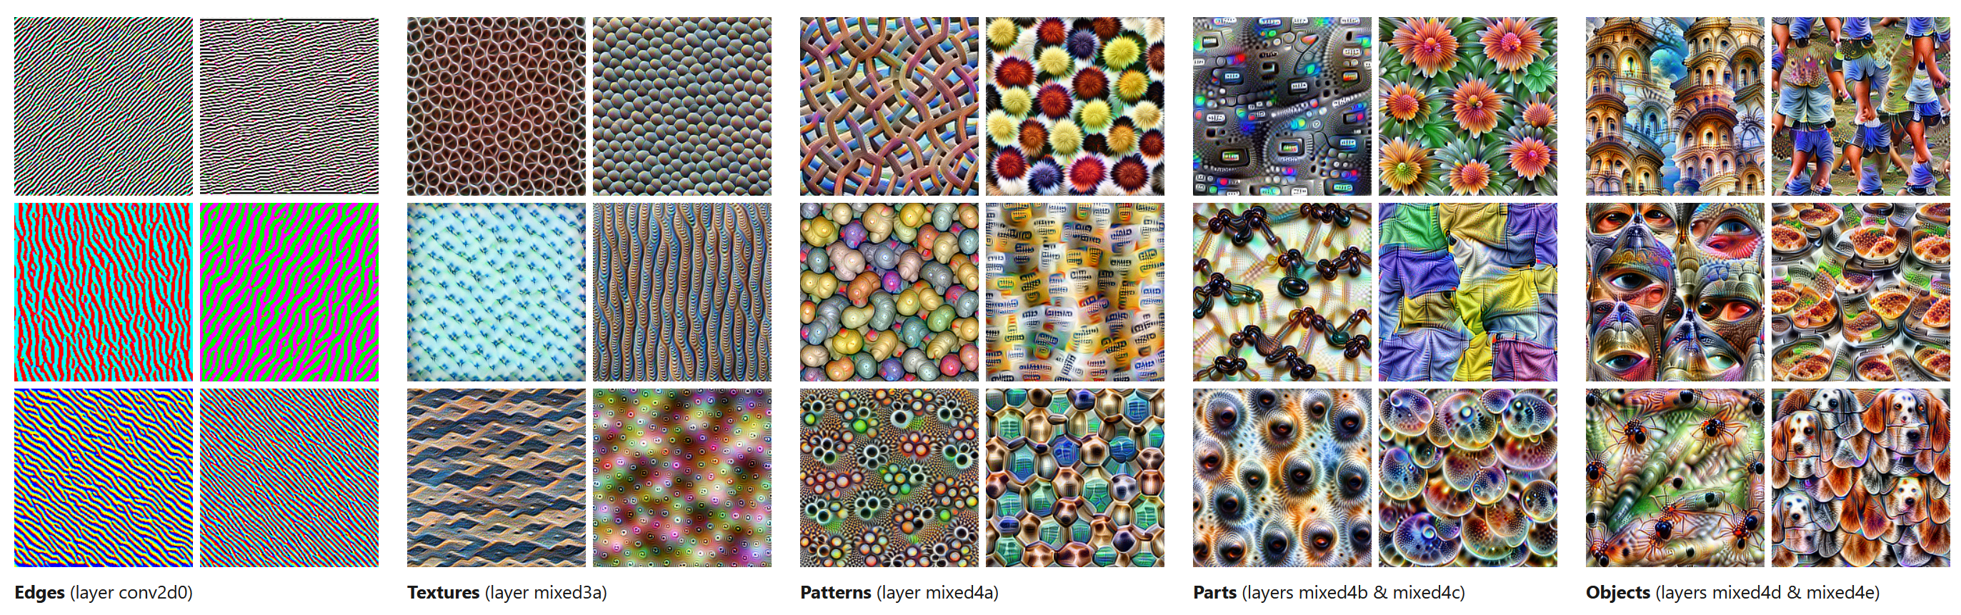
what computers see
https://distill.pub/2017/feature-visualization/
Machine Learning Methods for Biomedical Data (D012554)

Slide 39
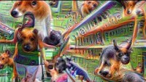
what computers see
Machine Learning Methods for Biomedical Data (D012554)
Notes:
https://www.youtube.com/watch?v=SCE-QeDfXtA

Slide 40
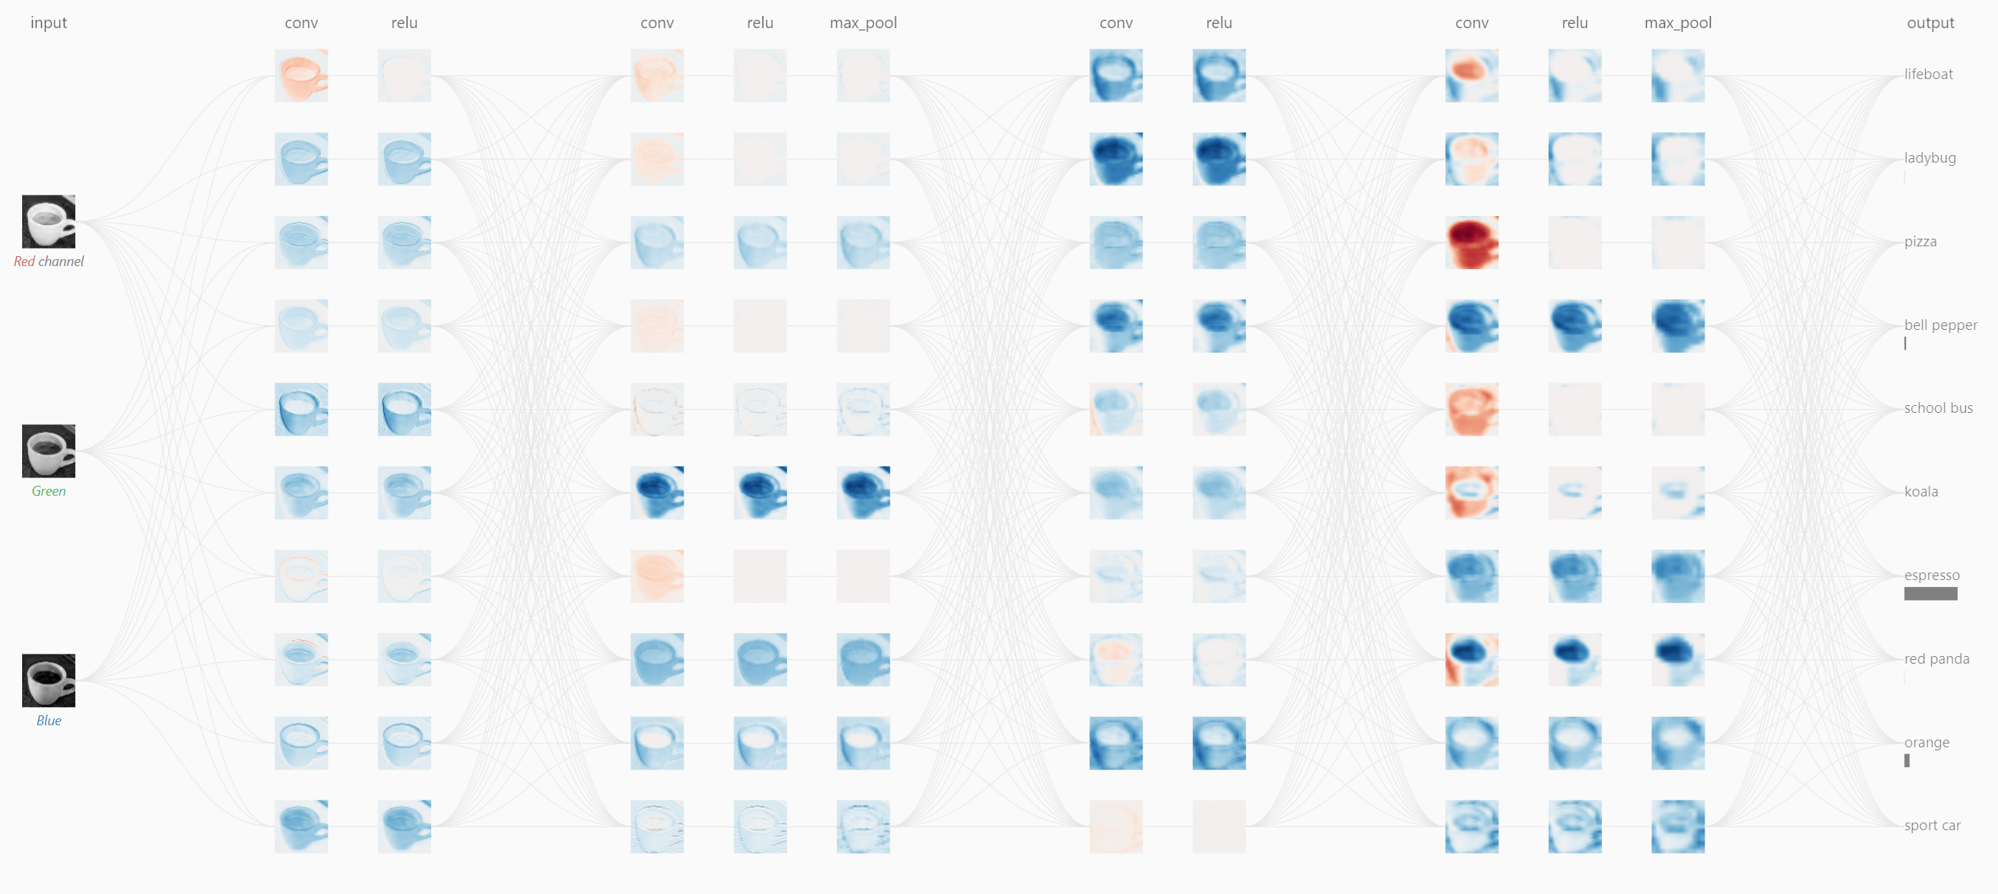
what computers see
https://poloclub.github.io/cnn-explainer/
Machine Learning Methods for Biomedical Data (D012554)
Notes:
Shifts
Scale
anngles
Shadows

Slide 41
transfer learning
Thrun et al., Dermatologist-level classification of skin cancer with deep neural networks, Nature (2017)
Machine Learning Methods for Biomedical Data (D012554)

Slide 42
transfer learning
Dermatologist-labelled dataset of 129.450 clinical images, including 3.374 dermoscopy images.
Thrun et al., Dermatologist-level classification of skin cancer with deep neural networks, Nature (2017)
Machine Learning Methods for Biomedical Data (D012554)

Slide 43
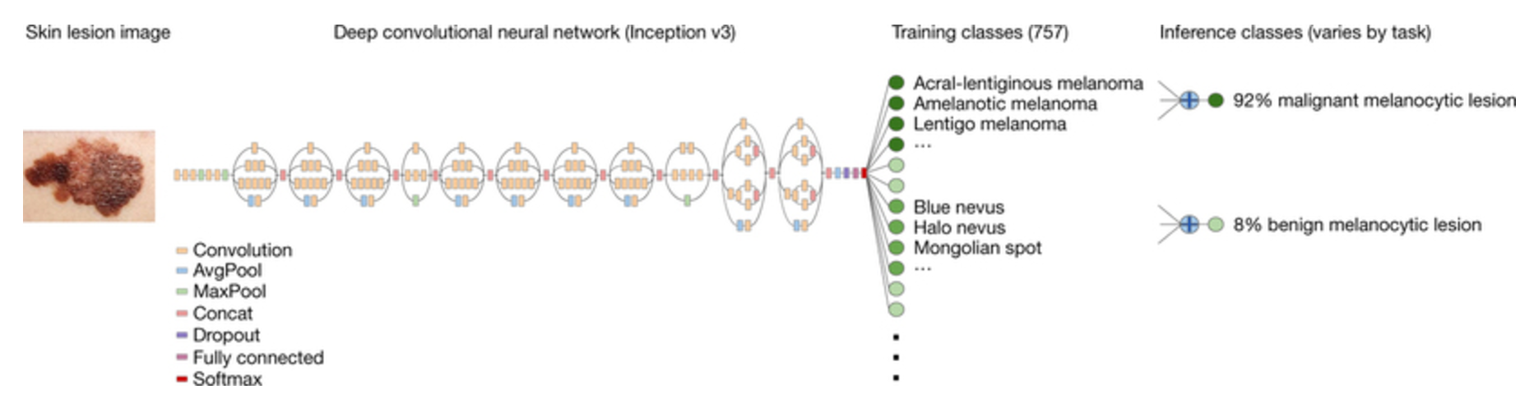
transfer learning
A pre-trained (on ImageNet) Inception v3 CNN was downloaded from GitHub.
The fully connected feed forward neural network module was replaced.
The network was then fine-tuned on the available lesion data. This means that the remainder of the modelparameters were used as the network’s initialization.
Thrun et al., Dermatologist-level classification of skin cancer with deep neural networks, Nature (2017)
Machine Learning Methods for Biomedical Data (D012554)

